Slide 1
Electro-optical parameters of CMOS Image Sensors for Measuring Applications
T. S. Djamiykov, T. N. Lazarov,
B. T. Ganev, D. S. Alexiev

Slide 2
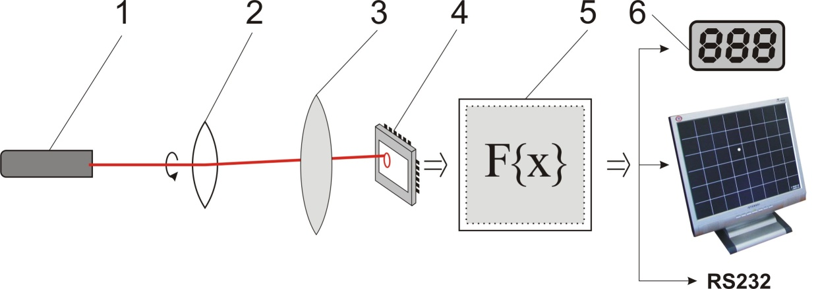
Block diagram of opto-electronic measuring system
1 – Light source
2 – Target
3 – Objective
4 – Image sensor
5 – Control and Processing Unit
6 – Display and Communication

Slide 3
Simplified vertical structure of image sensor

Slide 4
Bayer matrix RGB color filter array
0 … i-1 i i+1 i+2 … M-1
N rows, M columns
Pixel number K = M*N K = 0,5-10 MP
Color filters:
Red (R),
Green (G),
Blue (B)
0
…
j-1
j
j+1
j+2
…
N-1
B
G
B
G
B
G
B
G
G
R
G
R
G
R
G
R
B
G
B
G
B
G
B
G
G
R
G
R
G
R
G
R
B
G
B
G
B
G
B
G
G
R
G
R
G
R
G
R
B
G
B
G
B
G
B
G
G
R
G
R
G
R
G
R

Slide 5
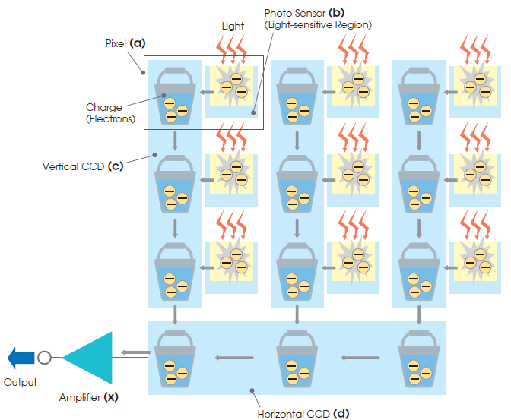
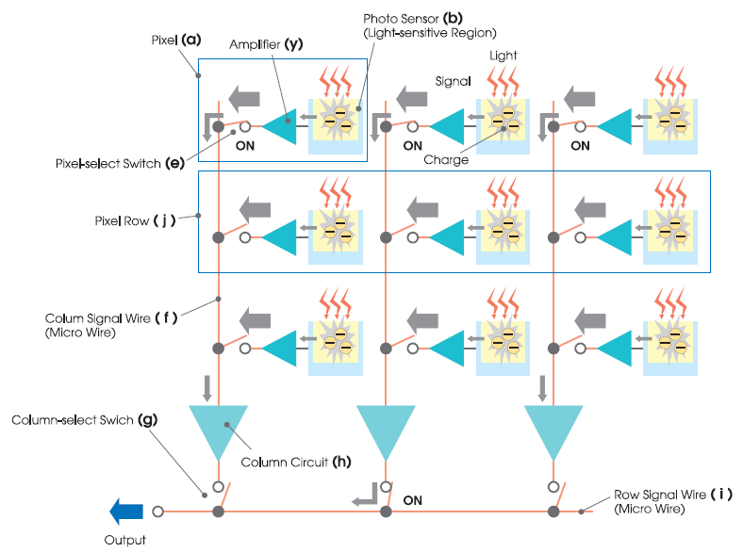
CCD vs. CMOS image sensors
CCD CMOS

Slide 6
CMOS image sensor distinctive features
“Active cell” pixel
Individual pixel addressing;
Analog-to-digital conversion;
Analog/digital processing to pixel/frame;
Embedded microcontroller system;
Embedded support subsystems;
Programmable parameters/functions;

Slide 7
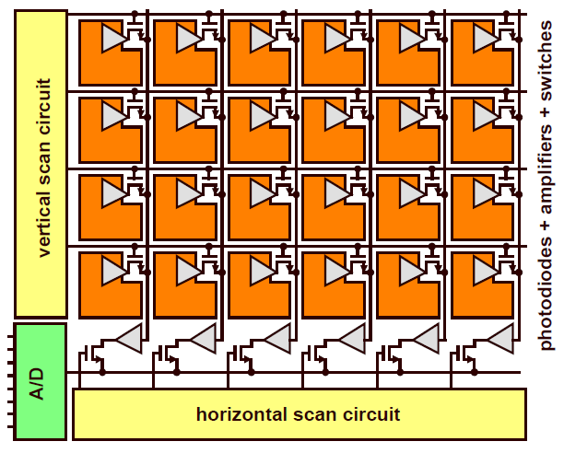
CMOS image sensor active pixel matrix

Slide 8
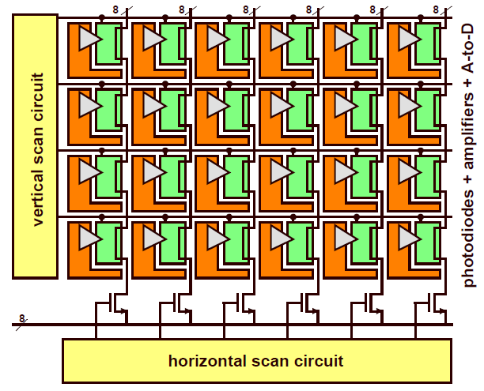
CMOS image sensor active pixel matrix 2

Slide 9
Sensor structure

Slide 10
Camera Chip

Slide 11
Functions and signal processing
Control of light-to-code transformation
Image quality control
Frame formatting

Slide 12
Device: Parameter: | MT9M012 | OV10633 | MT9D112 | OV3640 | MT9T031 | OV3640 | MT9P006 | OV5650 | MT9J003 | OV10810 | MT9H004 | OV16820
Resolution, MP | 1,6 | 1 | 2 | 2 | 3 | 3,1 | 5 | 5 | 10 | 10 | 16 | 16
Active array H | 1472 | 1280 | 1600 | 1920 | 2048 | 2048 | 2592 | 2592 | 3856 | 4320 | 4928 | 4608
V | 1096 | 720 | 1200 | 1080 | 1536 | 1536 | 1944 | 1944 | 2764 | 2432 | 3280 | 3456
Pixel size, µm | 2,2 | 4,2 | 2,2 | 3 | 3,2 | 1,75 | 2,2 | 1,75 | 1,67 | 1,4 | 4,78 | 1,34
Image area, mm H | 3,24 | 5,51 | 3,56 | 5,86 | 6,55 | 3,63 | 5,70 | 4,59 | 6,12 | 6,09 | 23,55 | 6,24
V | 2,41 | 3,42 | 2,68 | 3,28 | 4,92 | 2,71 | 4,28 | 3,42 | 4,59 | 3,45 | 15,68 | 4,68
Optical format, inch | 1/4,5 | 1/3 | 1/4 | 1/2,7 | 1/2 | 1/4 | 1/2,5 | 1/3,2 | 1/2,3 | 1/2,5 | 1,77 | 1/2,3
ADC, bits | 12 | 10 | 10 | 10 | 10 | 10 | 12 | 10 | 12 | 12 | 14 | 12
Dynamic range, dB | 70,1 | 115 | 59,5 | 69 | >61 | 60 | 76 | 69 | 65,2 | 71
SNR, dB | 38,1 | 39 | 37,7 | 39 |  | 36 |  | 37 |  | 35
Sensitivity, V/lux-sec | 1,4 | 3,65 | 0,53 | 3,3 | >1 | 0,49 | 1,76 | 1,3 | 0,31 | 0,72
Input clock, MHz | 49,5 | 6-27 | 6-54 | 6-27 | 48 | 6-54 | 96 | 6-27 | 6-48 | 6-27 | 46,4 | 6-27
Max. frame rate, fps Full resolution | 30 | 30 | 15 | 30 | 12 | 15 | 15 | 15 | 15 | 30 | 10,48 | 30
Video mode | 60 |  | 30 | 60 | 43 | 30 | 60 | 30/60 |  | 30/60 | 60 | 30/60
Max. data rate, Mb/s |  |  |  | 800 |  |  |  |  | 2800 |  | 2592
MP/s | 99 |  | 40 |  | 48 |  | 96 |  | 80
Data output: Parallel | 12 | 10 | 10 | 10 | 10 | 10 | 12 | 10 | 12 | 12 |  | 12
MIPI |  |  | x1 | x1 |  | x2 |  | x2 | x4 | x8 |  | x8
LVDS |  |  |  |  |  |  |  |  |  | x8 | х8 | x8
Supply Voltage, V I/O | 2,6-3,1 | 1,7-3,6 | 1,7-3,1 | 1,7-3,6 | 3,3 | 1,7-3,0 | 1,7-3,1 | 1,8/ 2,8 | 1,8/ 2,8 | 1,7-3,0 | 3,3 | 2,8/ 1,8
Analog | 2,8 | 3,3 | 2,8 | 3,3 | 3,3 | 2,8 | 2,8 | 2,8 | 2,8 | 2,8 | 3,3 | 2,8
Digital | 1,8 |  | 1,8 | 1,5 | 3,3 | 1,5 | 1,8 | 1,5 | 1,8 | 1,5 | 1,8 | 1,2
Power consumption: Active, mW | 365 | 532 | 245 | 357 | 244 | 79 | 366 | 150 | 638 | 230 |  | 310
Standby, µW |  | 480 | 10 | 70 | 1,65 | 20 |  | 40 |  | 40 |  | 10
Main parameters
Pixel number: 0,5-10 MP
Pixel size: 1,4-5,6 µm
ADC resolution: 8-12 bits
Sensitivity: 0,3-3,5 V/lux-sec
Clock frequency: 5-55(80) MHz
Power supply: 1,5/2,8/3,3V
Consumption: 250-400 mW
Sleep mode: 10-70 µW
Data: parallel/high-speed serial
User interface: I2C (+SPI)

Slide 13
CMOS image sensors trends
Parameters improvement:
  Decreasing pixel size
  Increasing number of pixels
  Increasing ADC resolution
  Increasing sensitivity
System integration:
  Embedded HW subsystems
  Variety of functions and settings
  System-on-Chip – Camera-Chip

Slide 14
Conclusion
Smaller pixel -> Higher accuracy
Higher sensitivity and pixel number -> more information
Embedded image processing saves system resources
Camera-Chip simplifies system design and integration
Choice of sensor = f (application, processing algorithm, task parameters, available resources – time, HW, energy)

Slide 15
Thank you for your attention!

